Slide 1
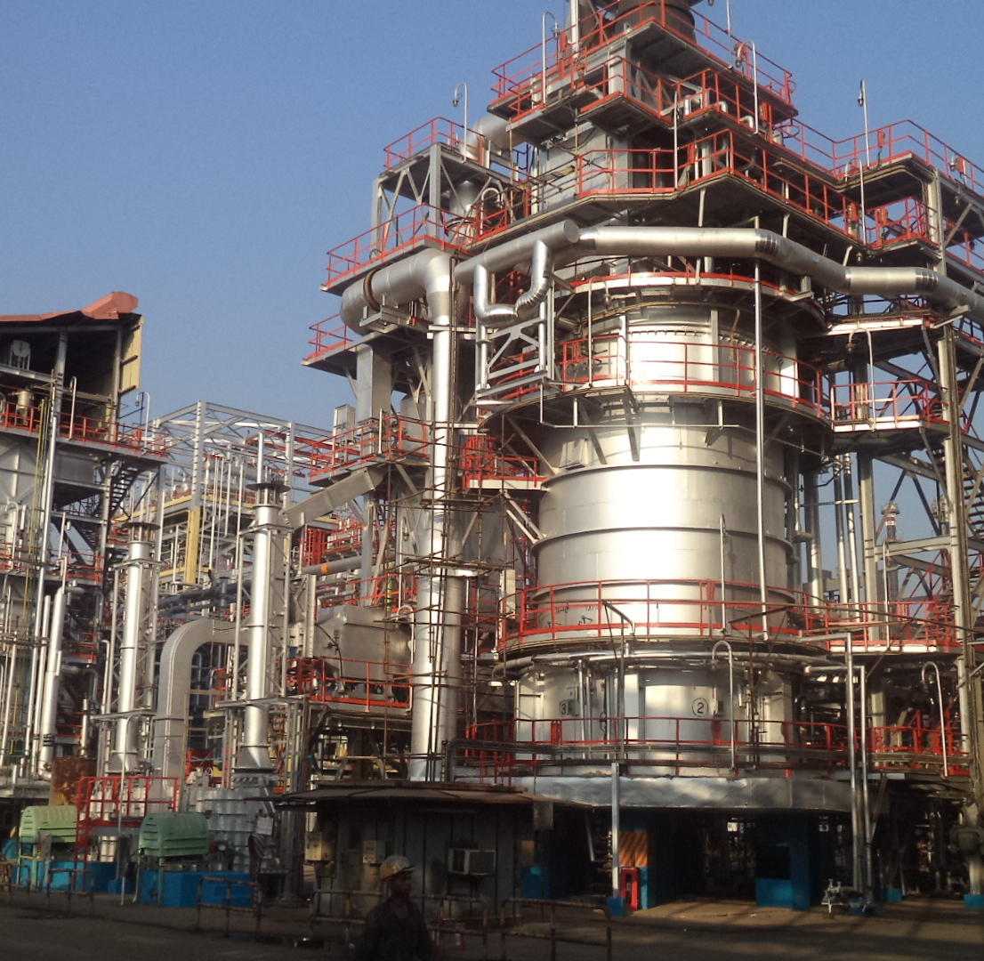

Trimurti Fabricators
PVT ltd
Company Profile

Slide 2
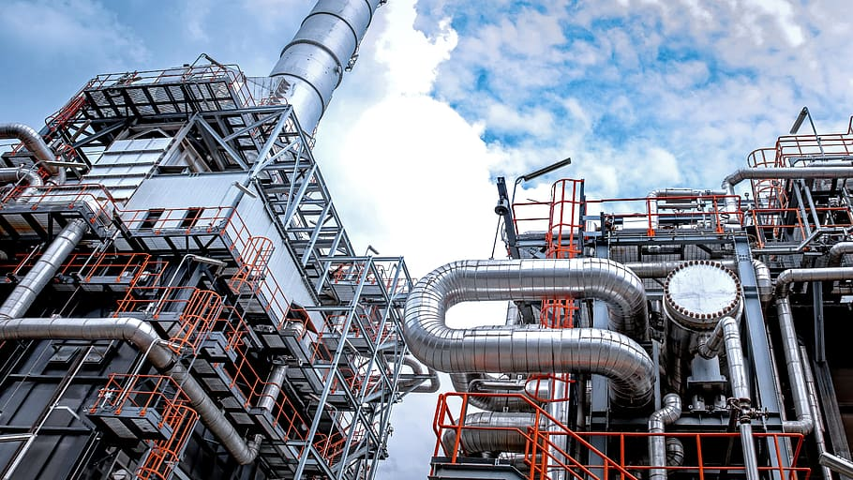
About us
We, Trimurti Fabricators Pvt Ltd are a well-established contractor firm operating in mechanical fabrication activities like piping, Structural work, tank fabrications & all kind of erection activities
We have served a number of clients across different sectors and have operated pan India for over 30 years.
Corporate office : Panvel, Maharashtra, INDIA
Manufacturing facility : Taloja midc, panvel
PRIVATE LTD COMPANY SINCE 1999
OVER 30 YEARS OF MECHANICAL CONSTRUCTION EXPERIENCE

Slide 3
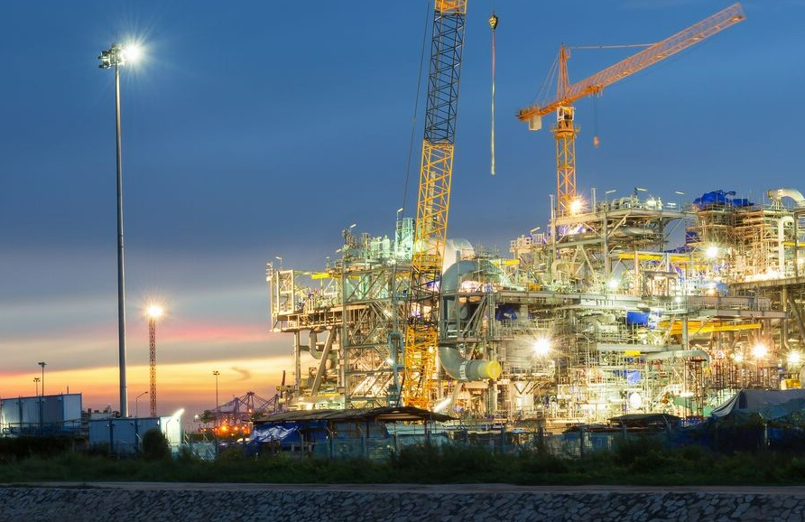
VISION & MISSION
Our Vision :
To become a reputed and trusted player in the construction industry, known for delivering excellence, innovation, and integrity in every project
Our Mission :
Build enduring, mutually beneficial relationships by consistently exceeding our clients’ expectations through high quality construction services
Commit to providing a safe, challenging, and rewarding work environment where our employees thrive and contribute to excellence in the construction industry
Our Core Ideology :
Strive for exceeding customer expectations through excellence & integrity
Commit to safety and wellbeing of employees
Operate the business at a healthy profit to allow growth and sustainability
Continuously strive to improve and take on new challenges

Slide 4
What we offer

Slide 5
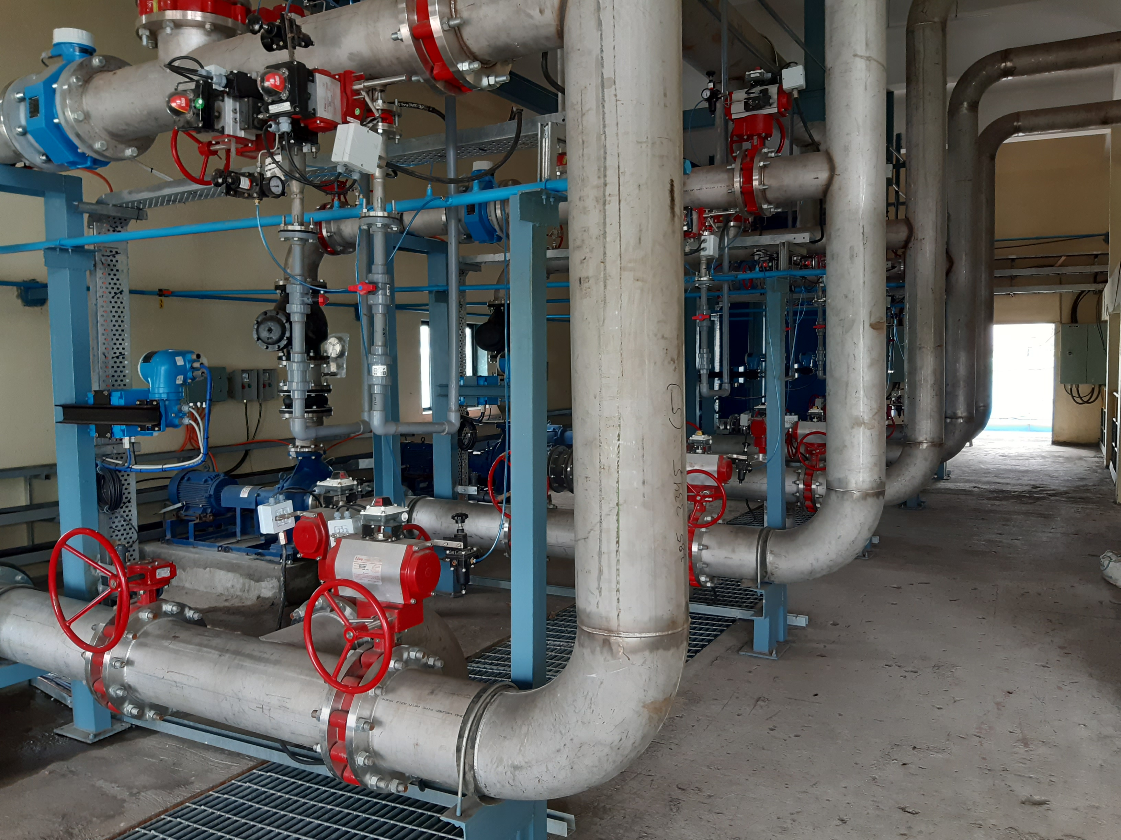
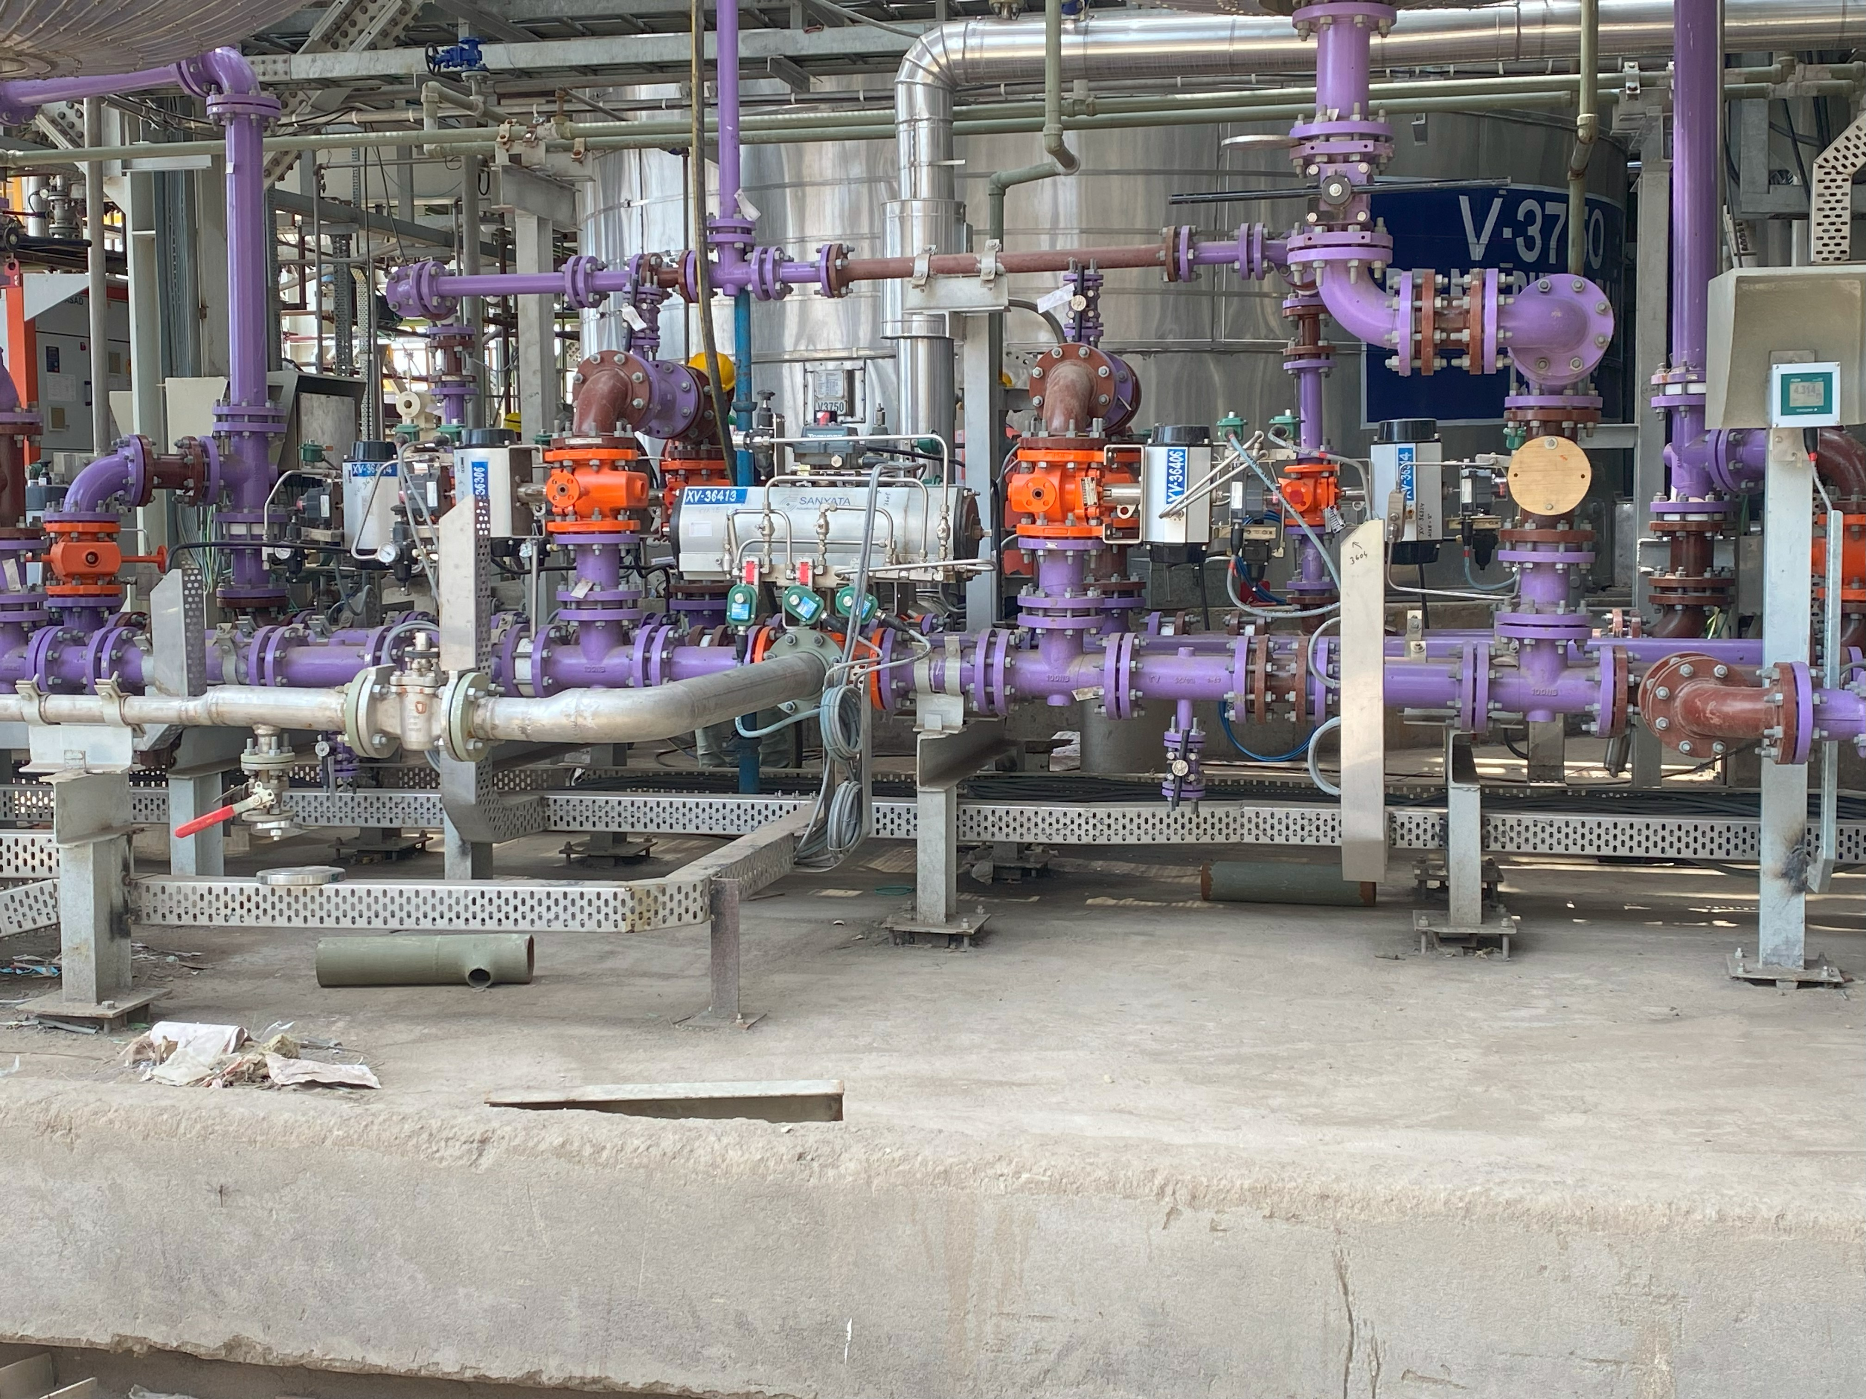
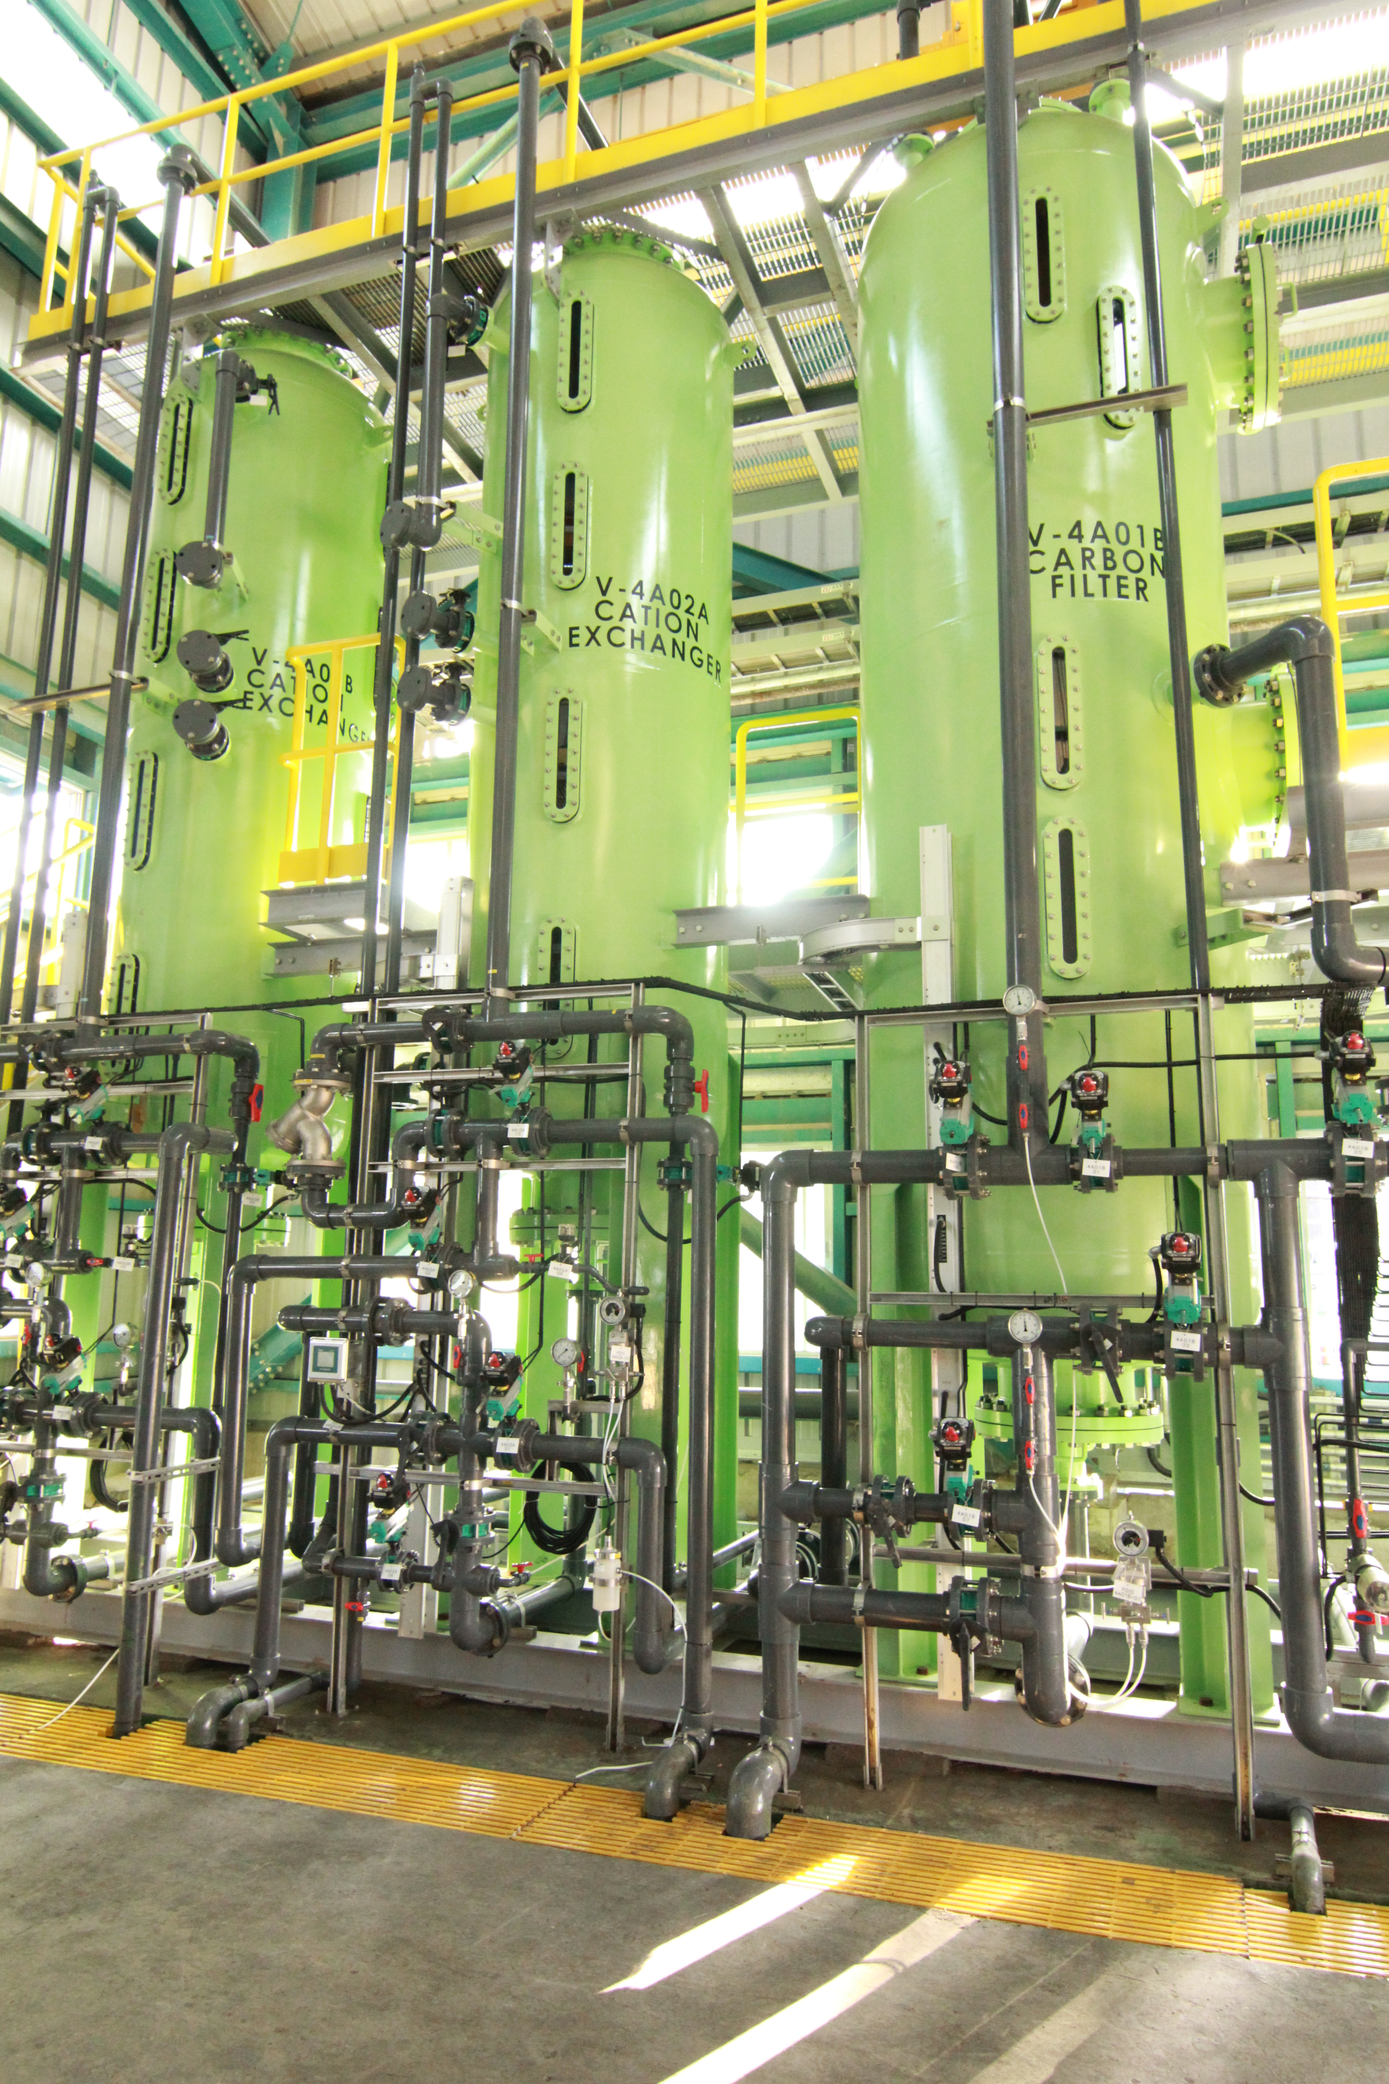
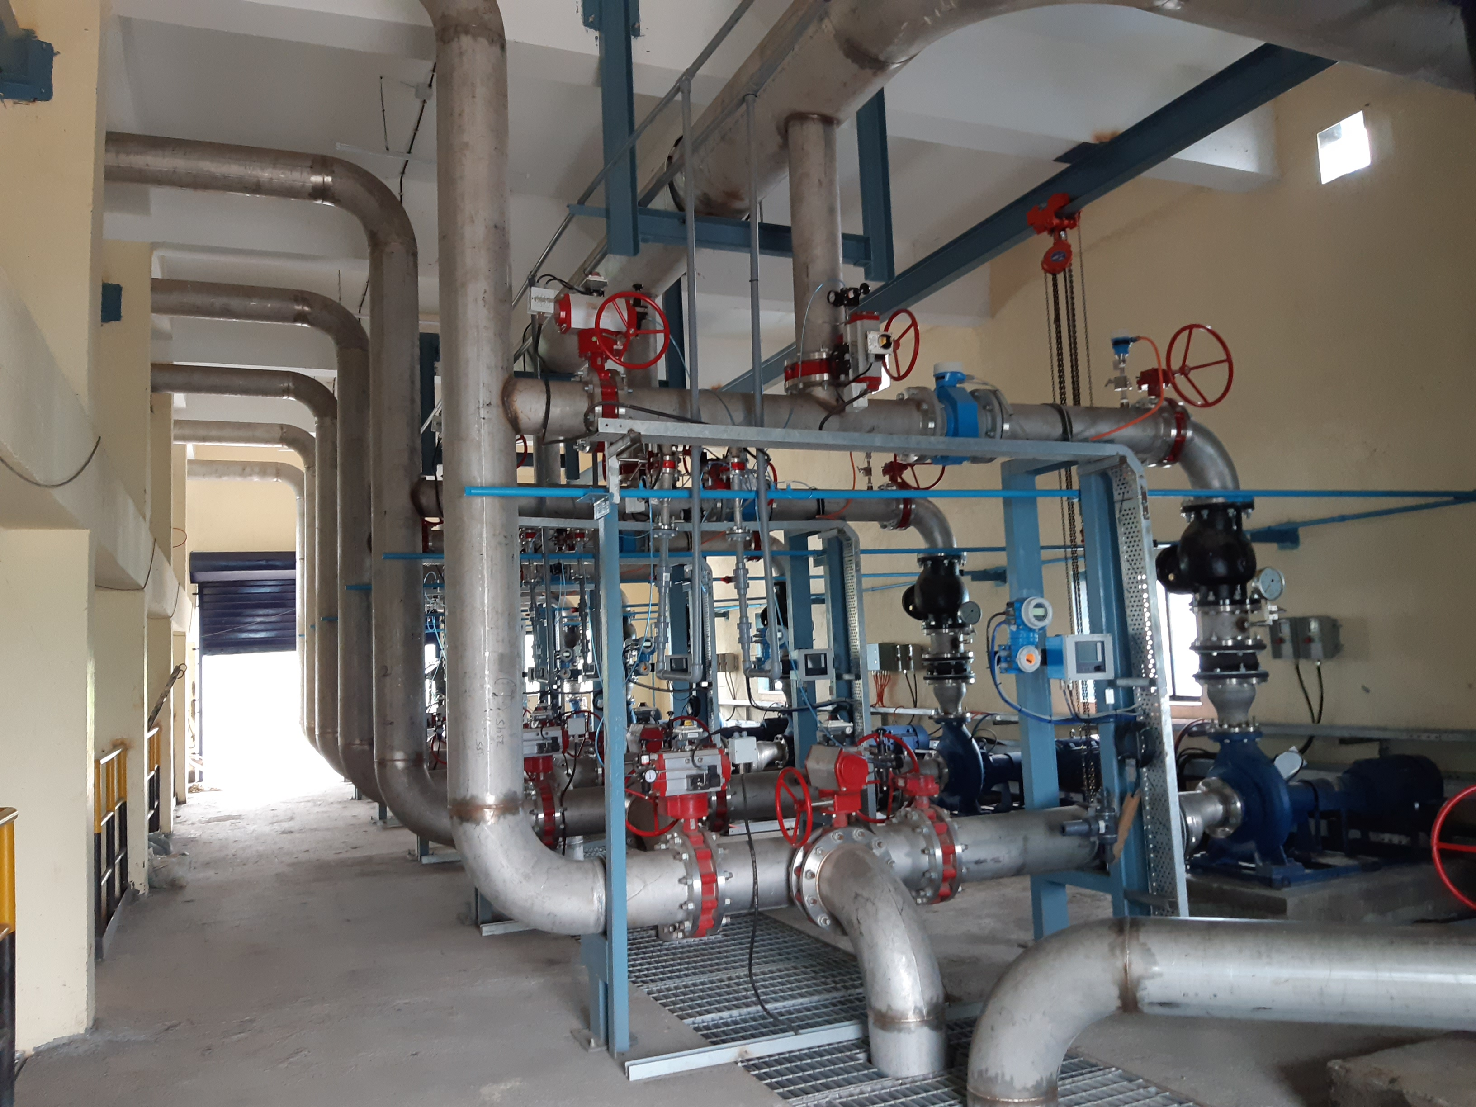
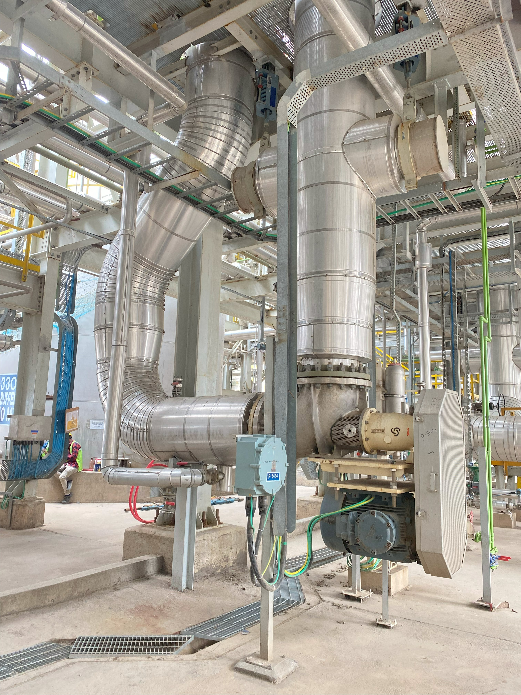
Process & utility piping (s.s./c.s./alloy steel)

Slide 6
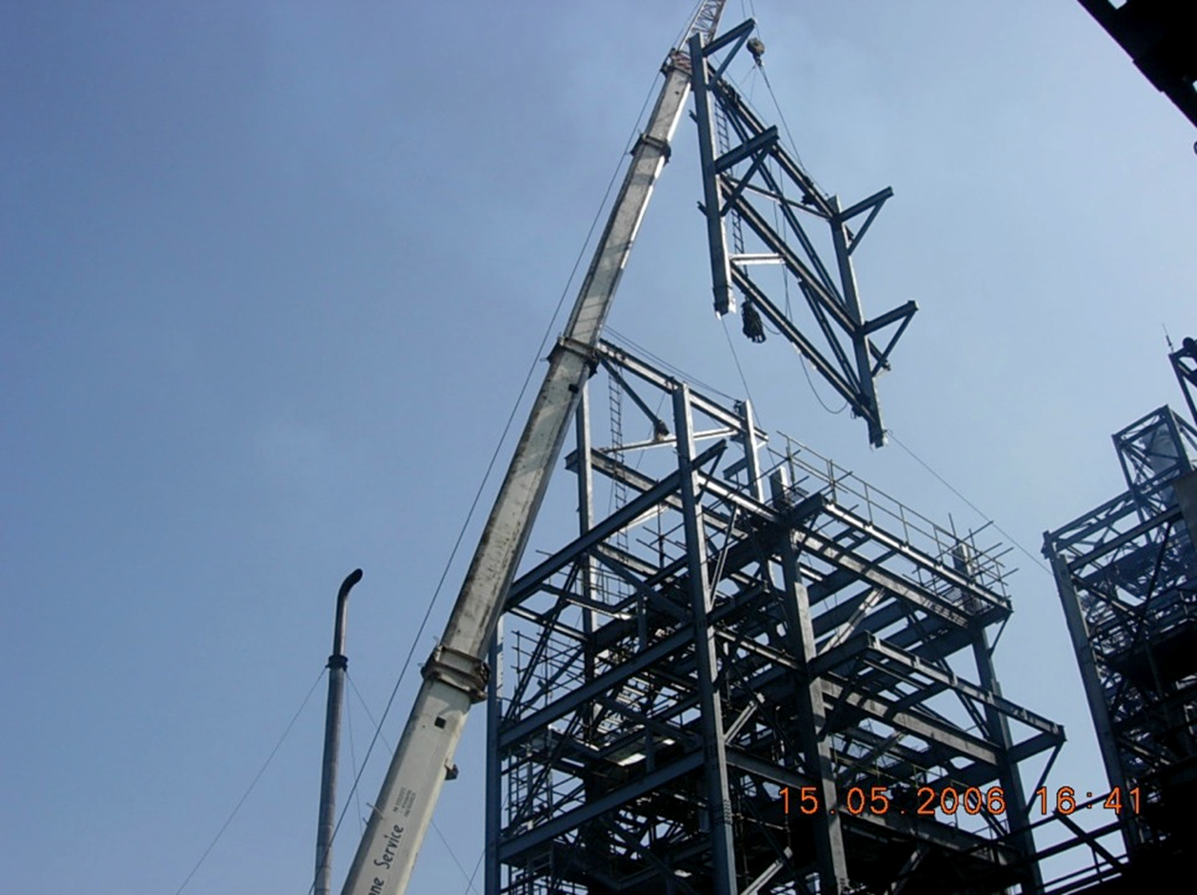
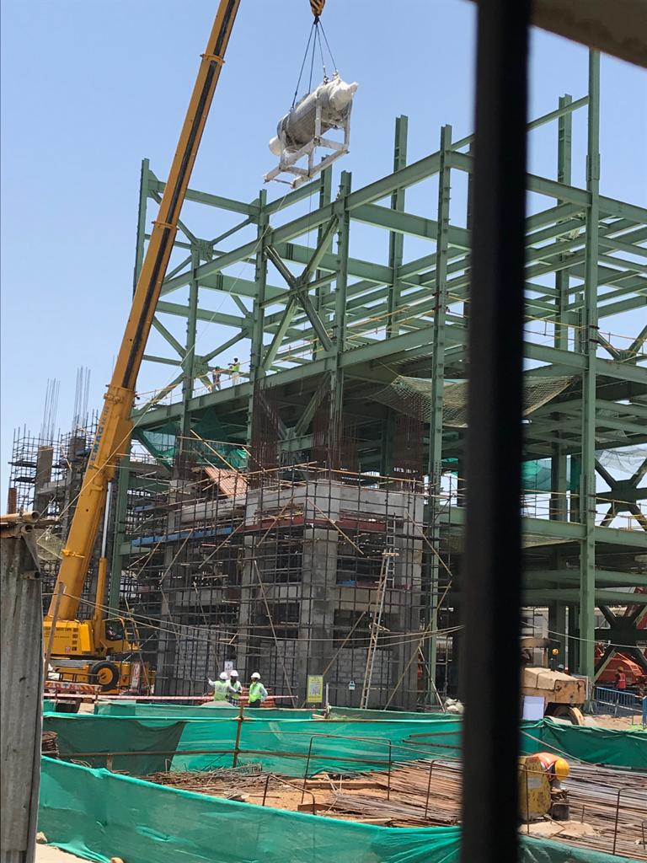
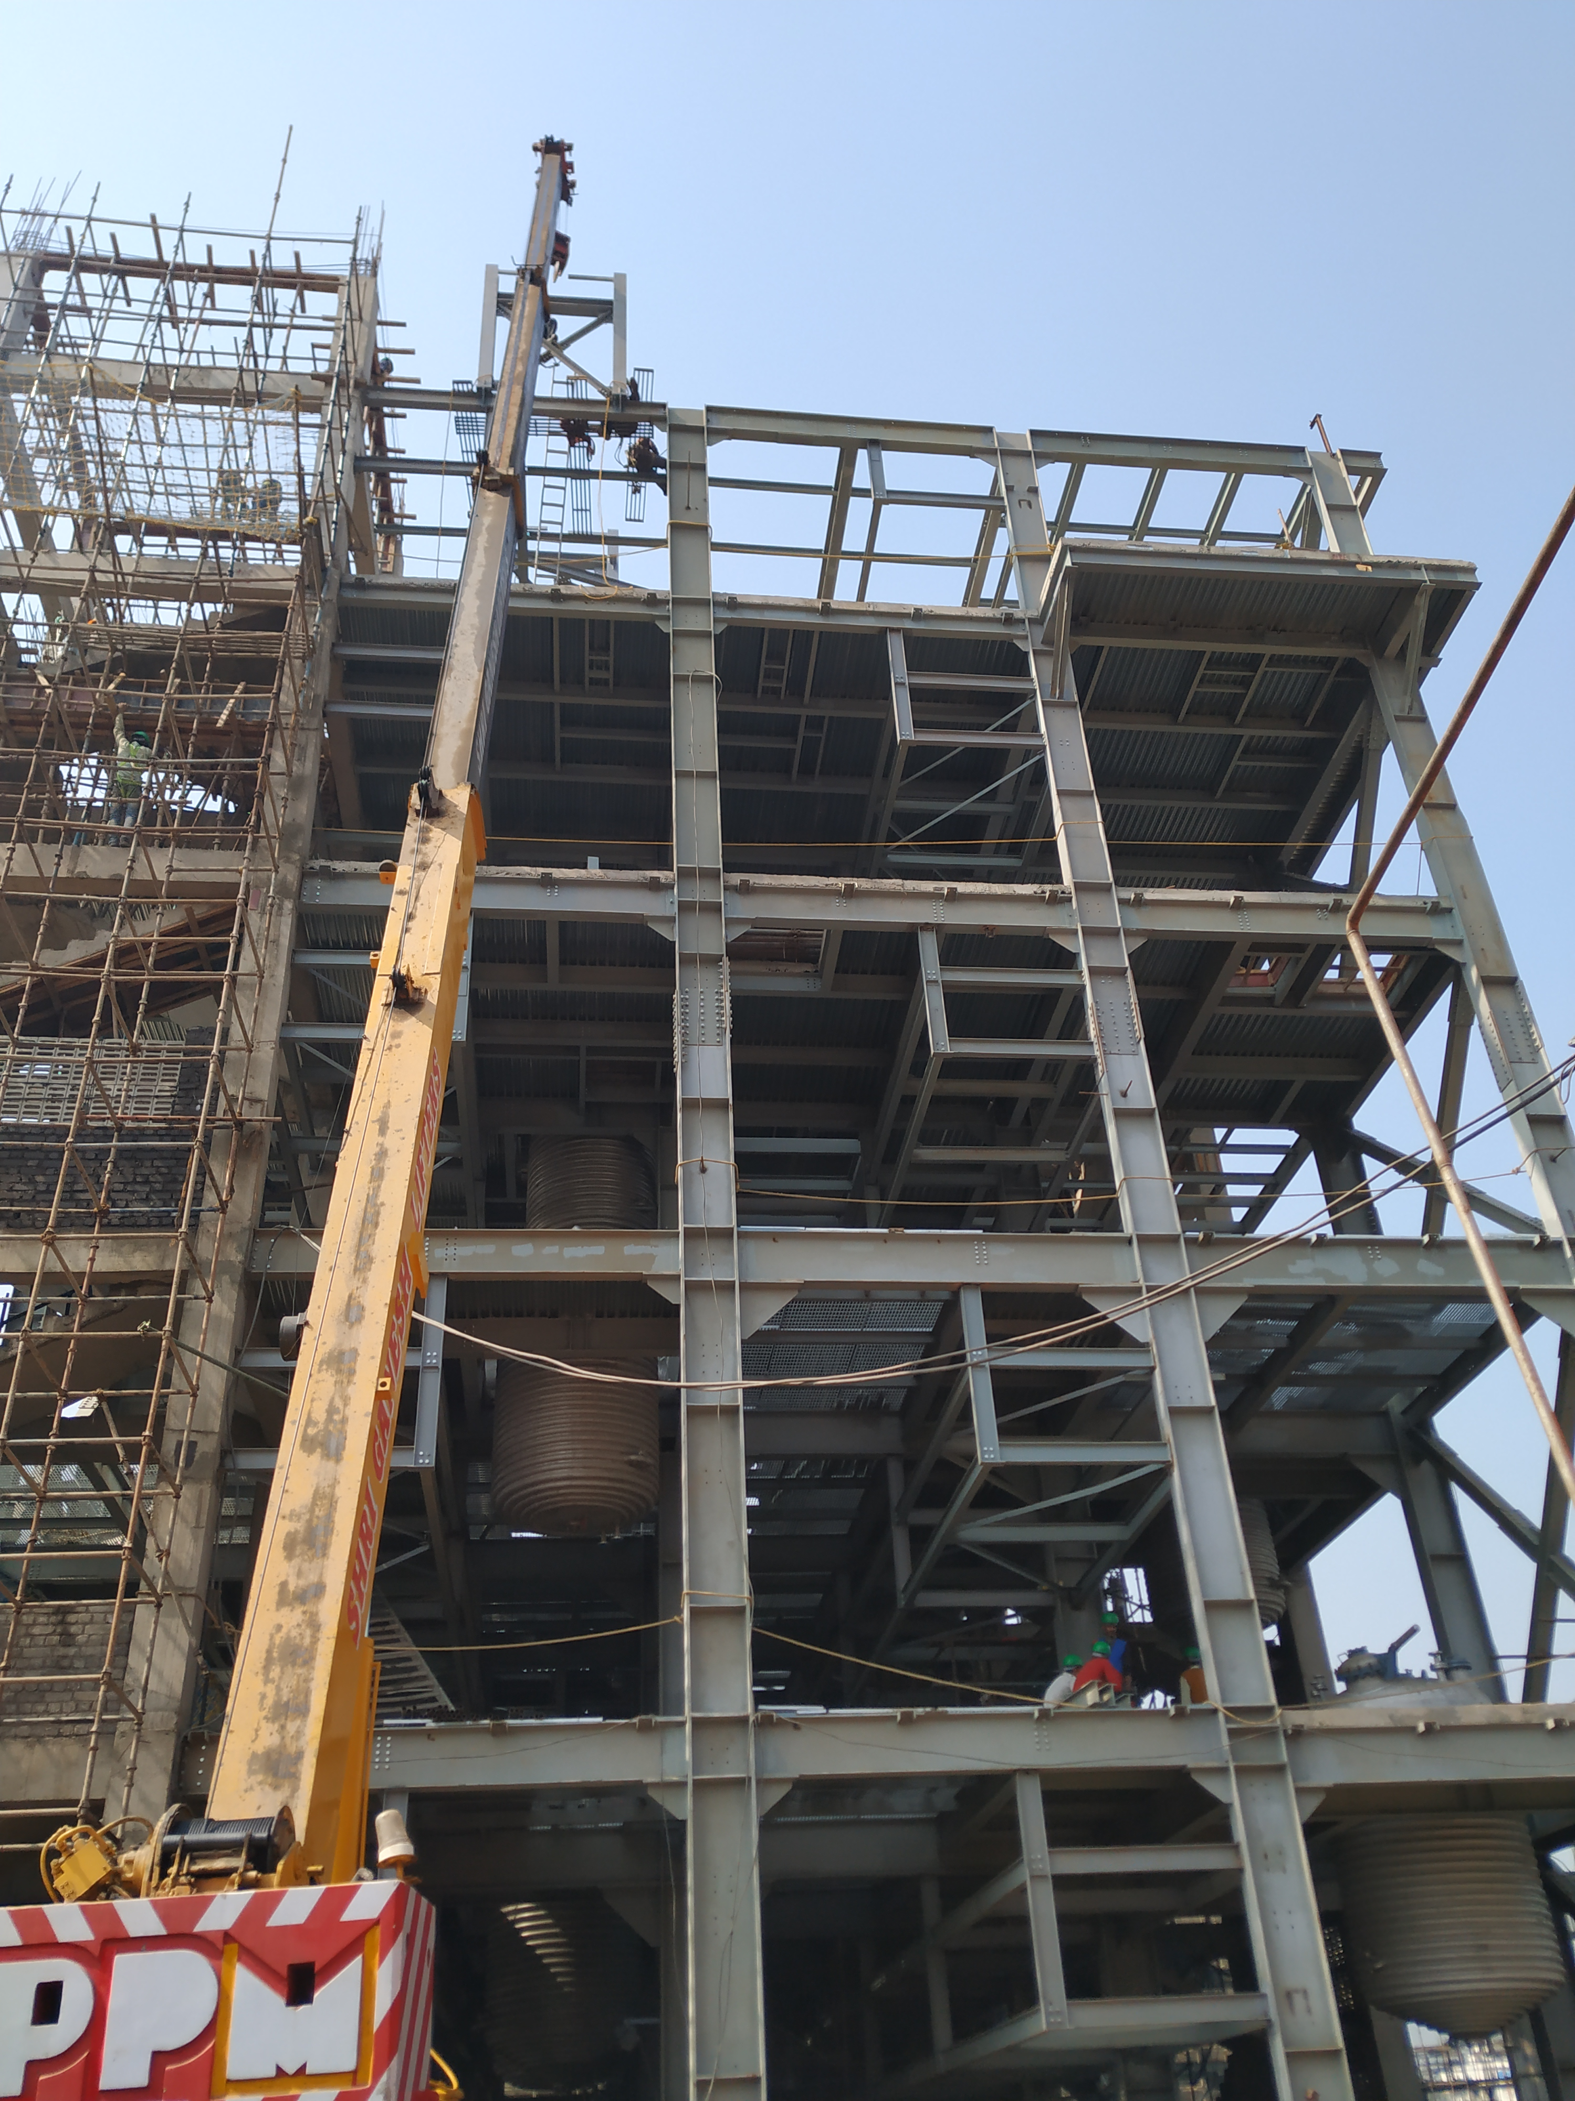
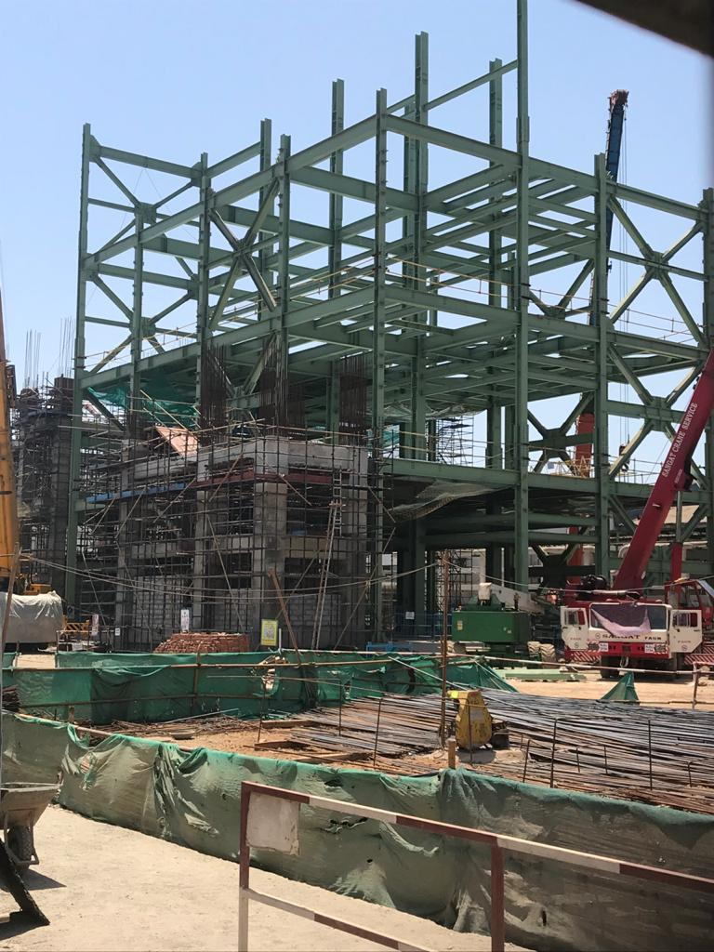
Structural FABRICATION & ERECTION

Slide 7
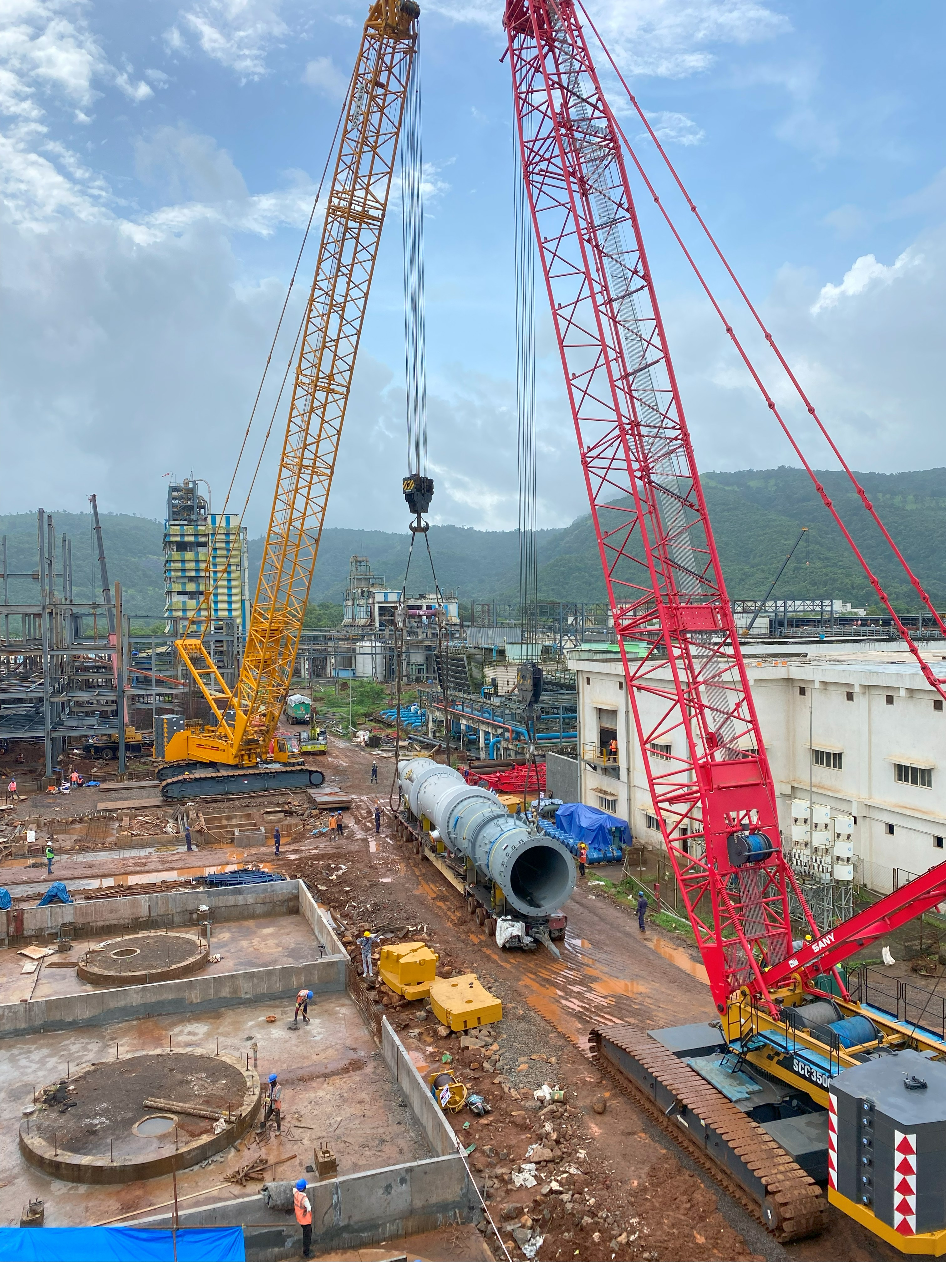
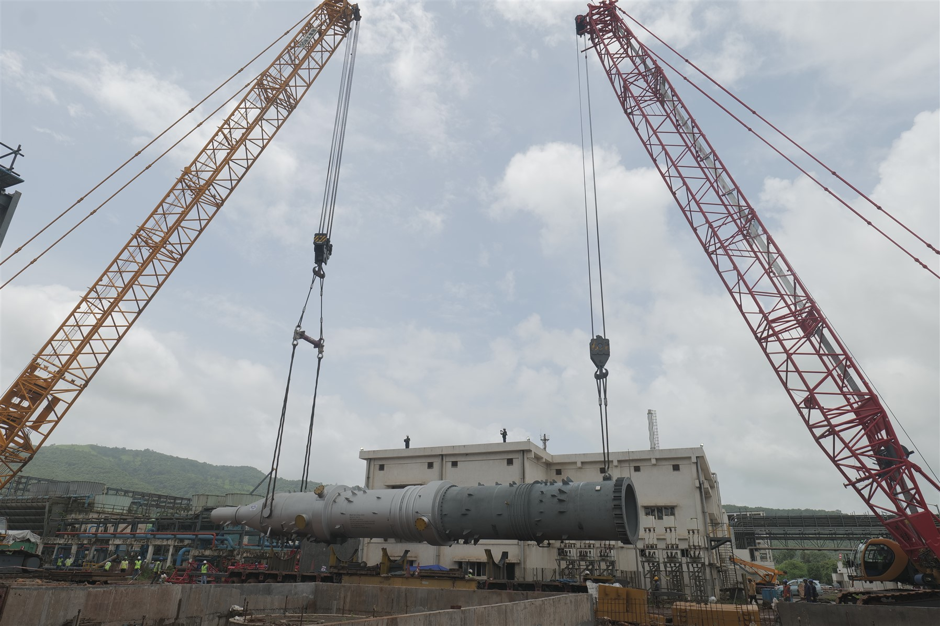
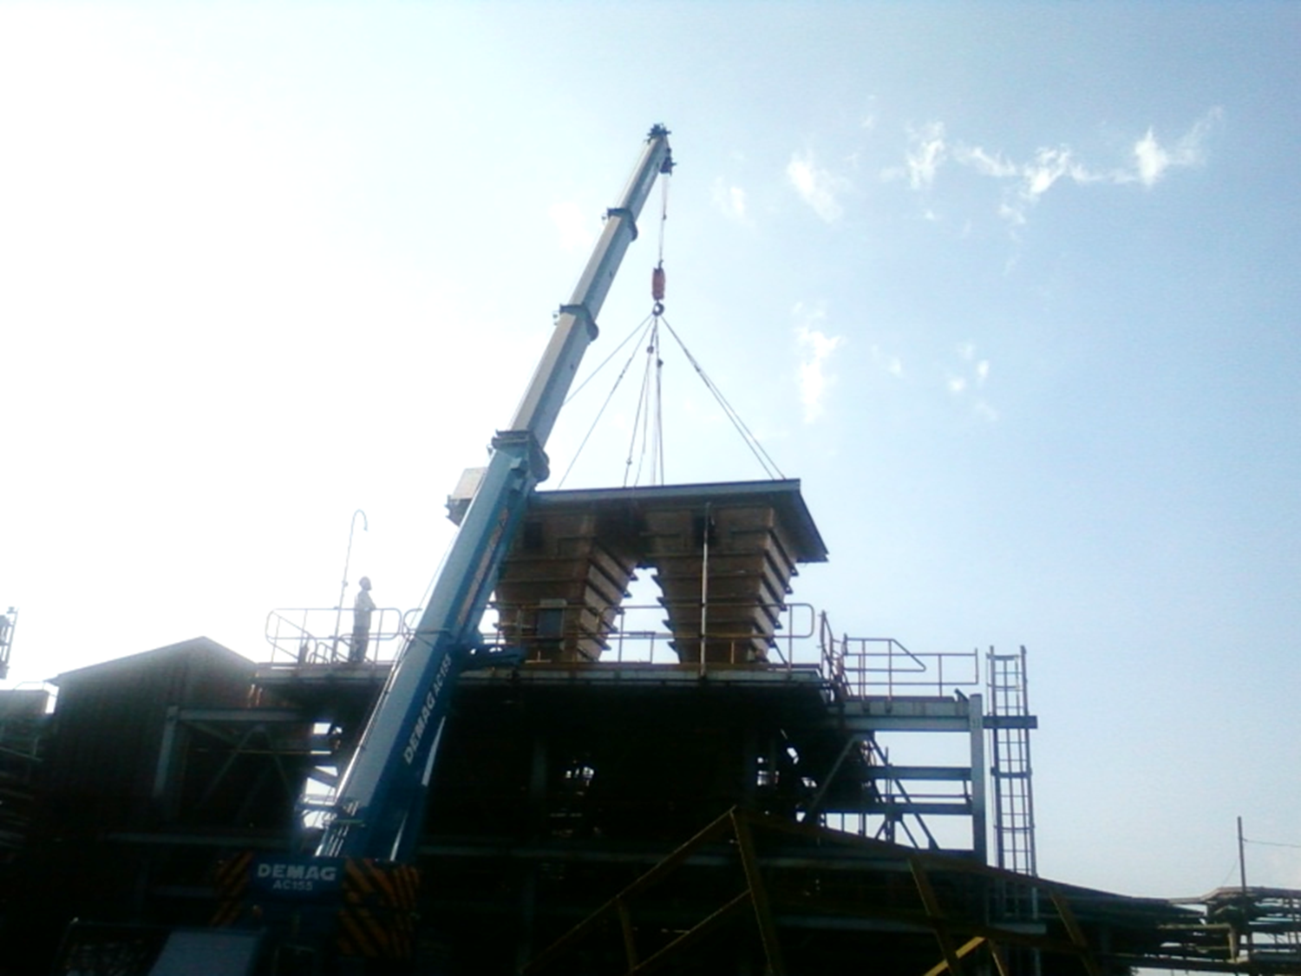
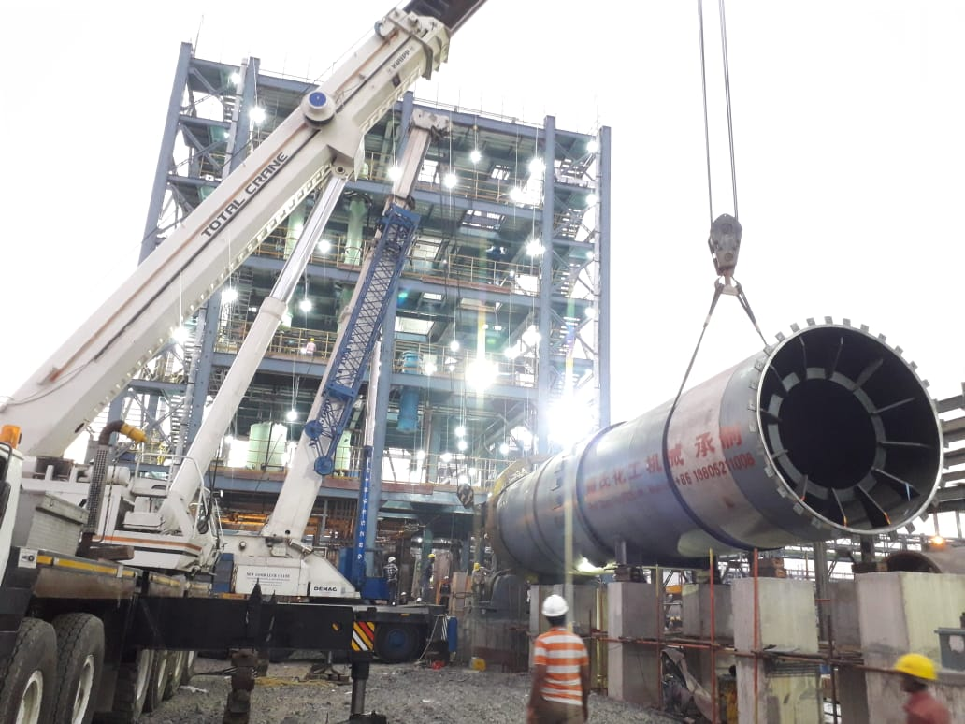
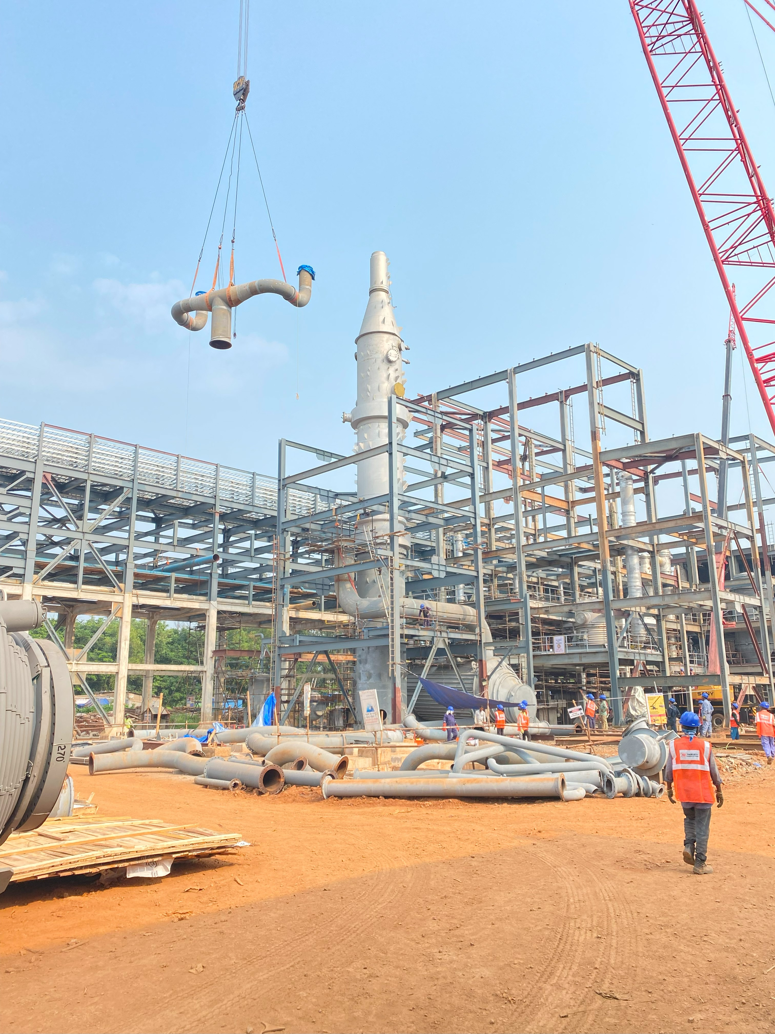
ERECTION OF EQUIPMENT

Slide 8
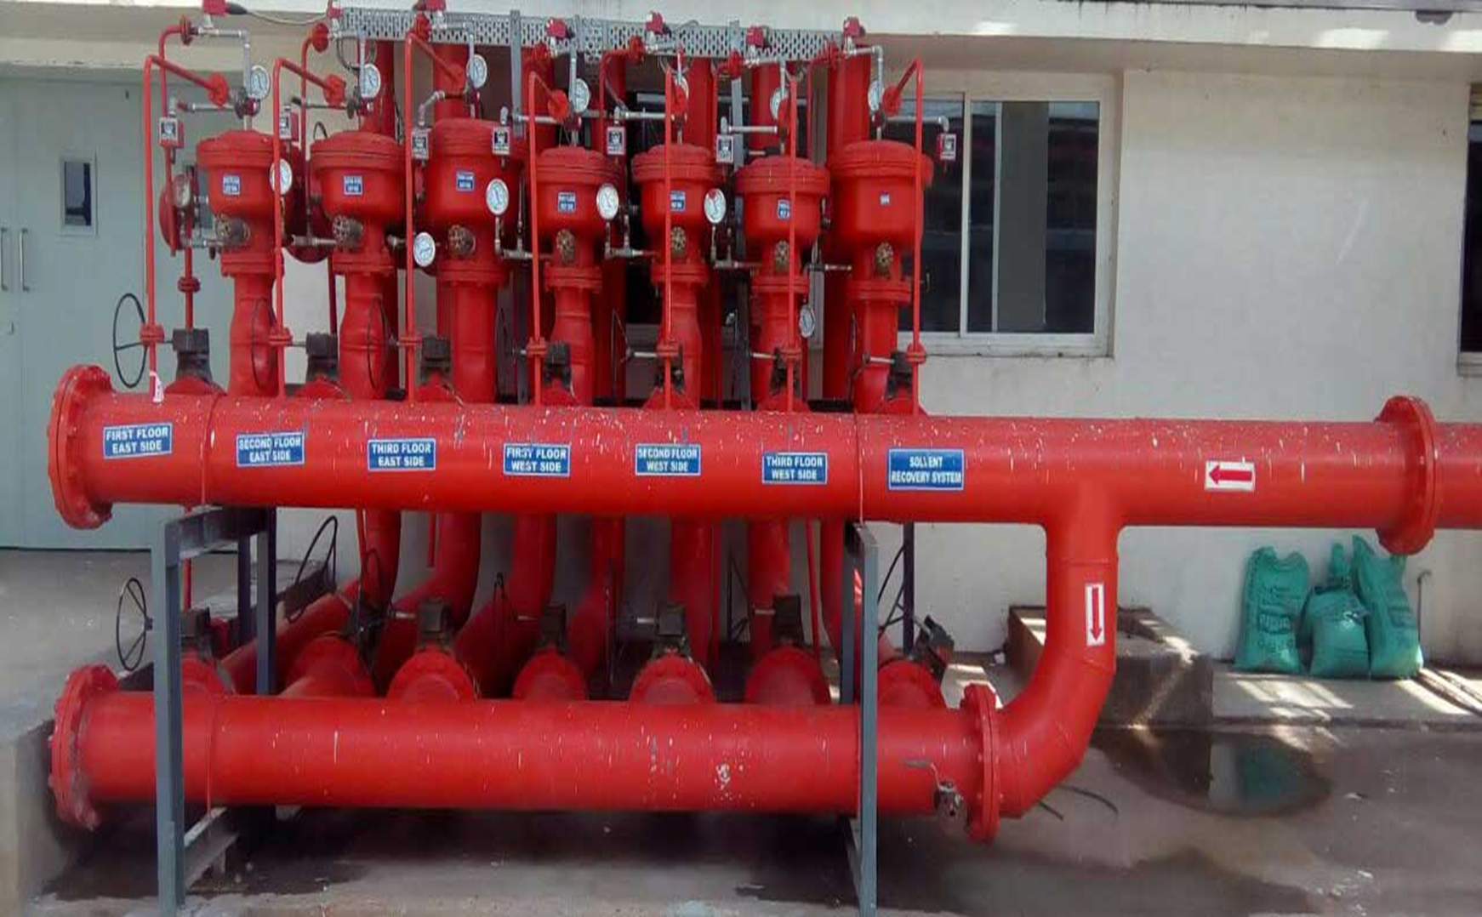
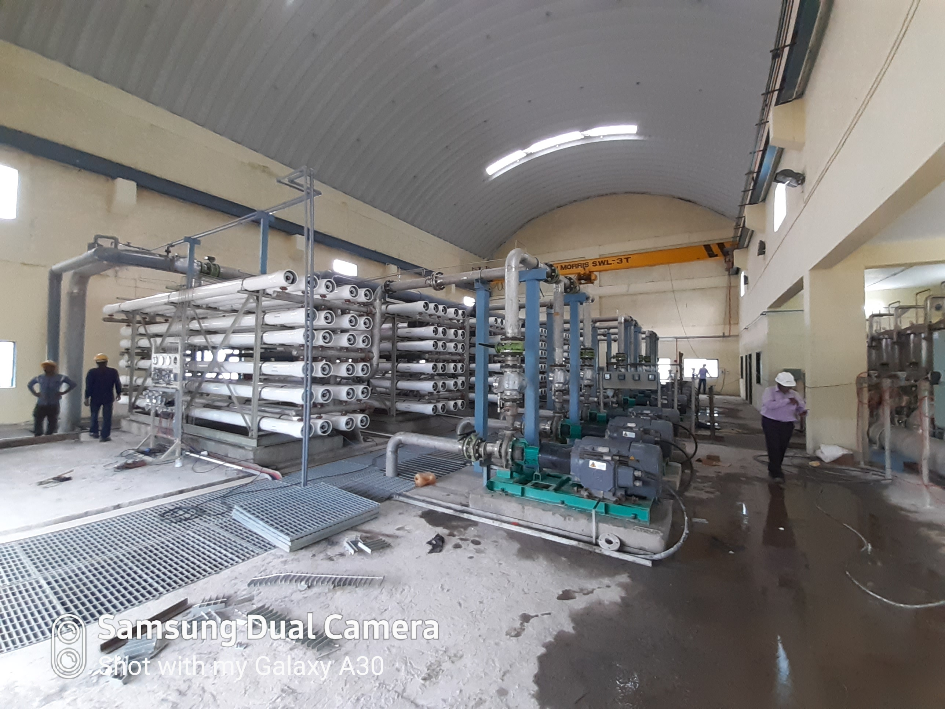
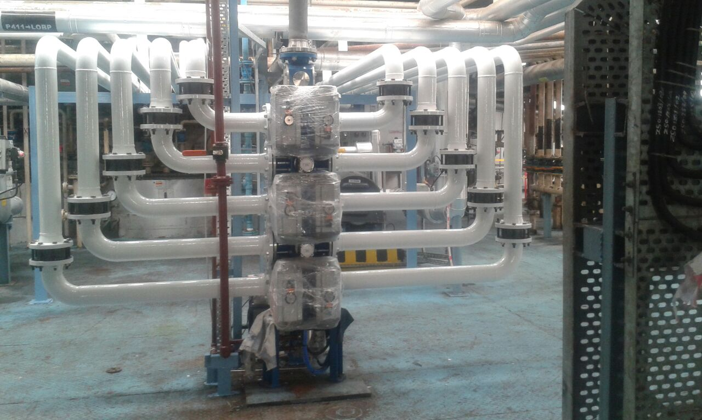
Design, supply & installation of fire sprinkler systems

Slide 9
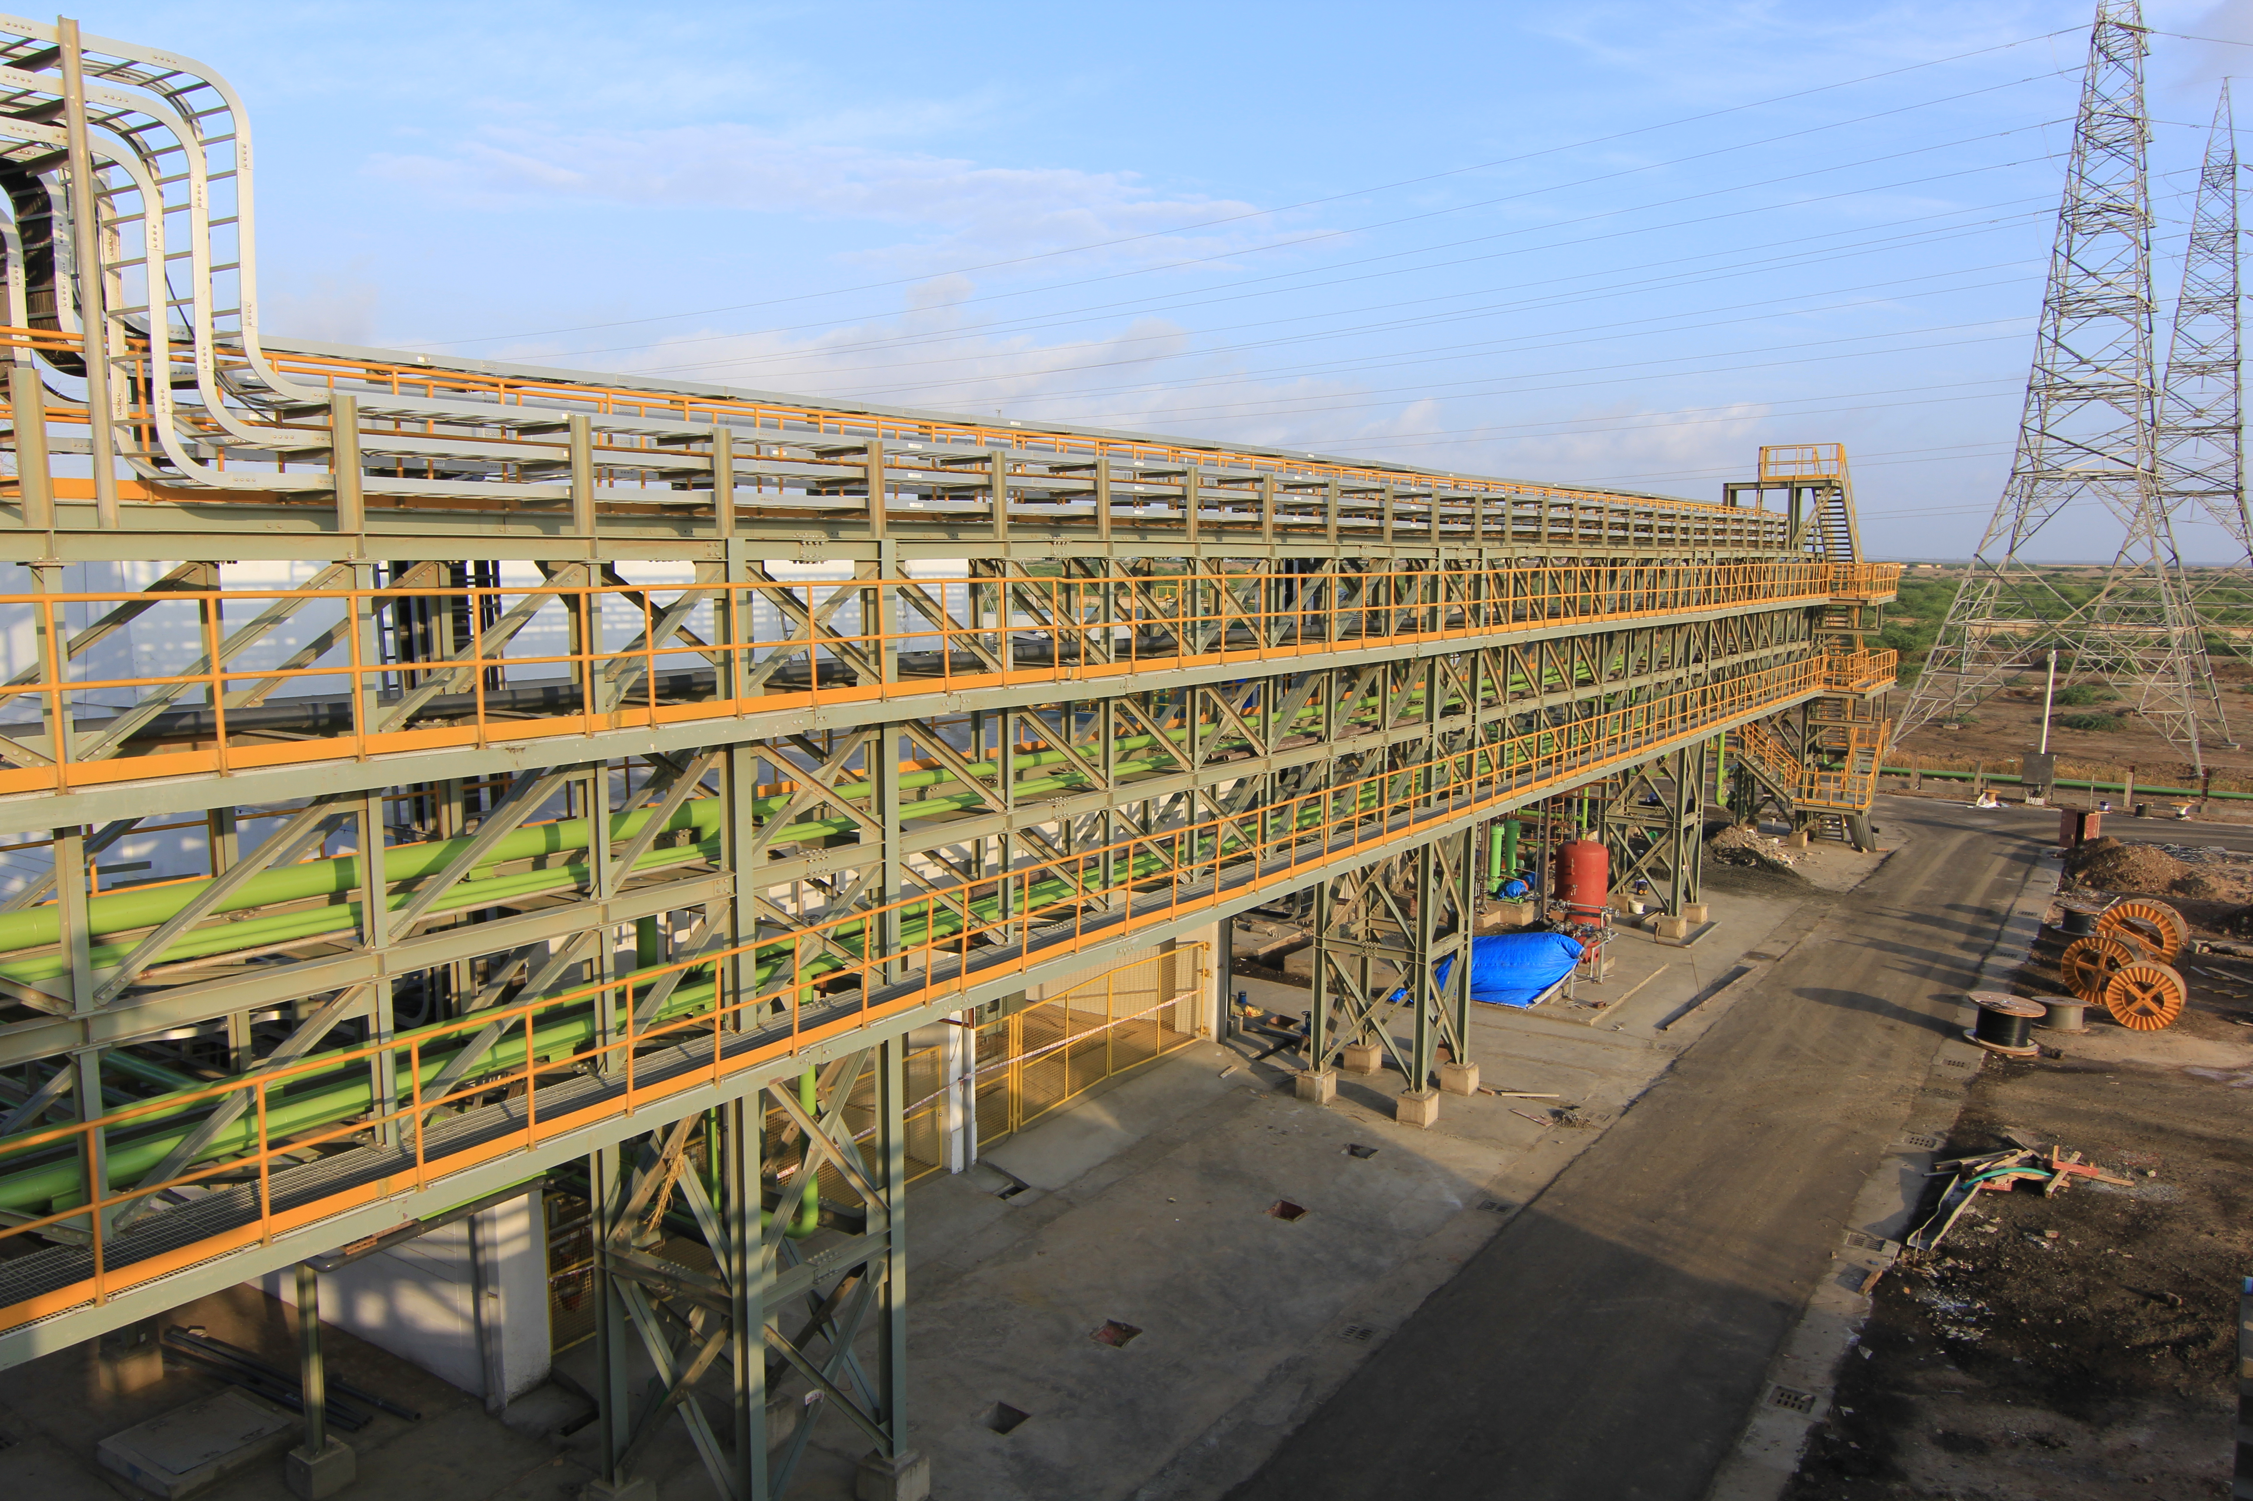
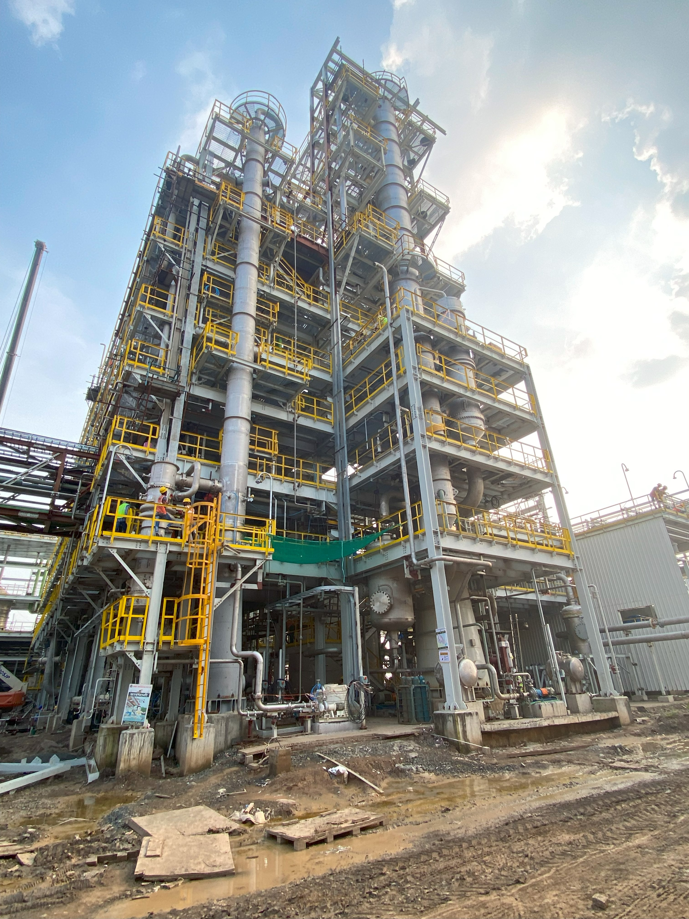
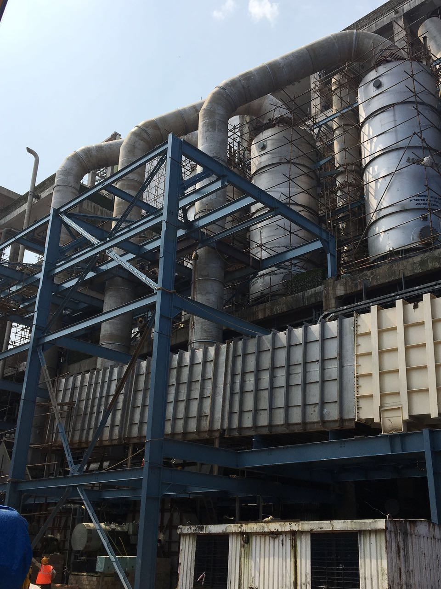
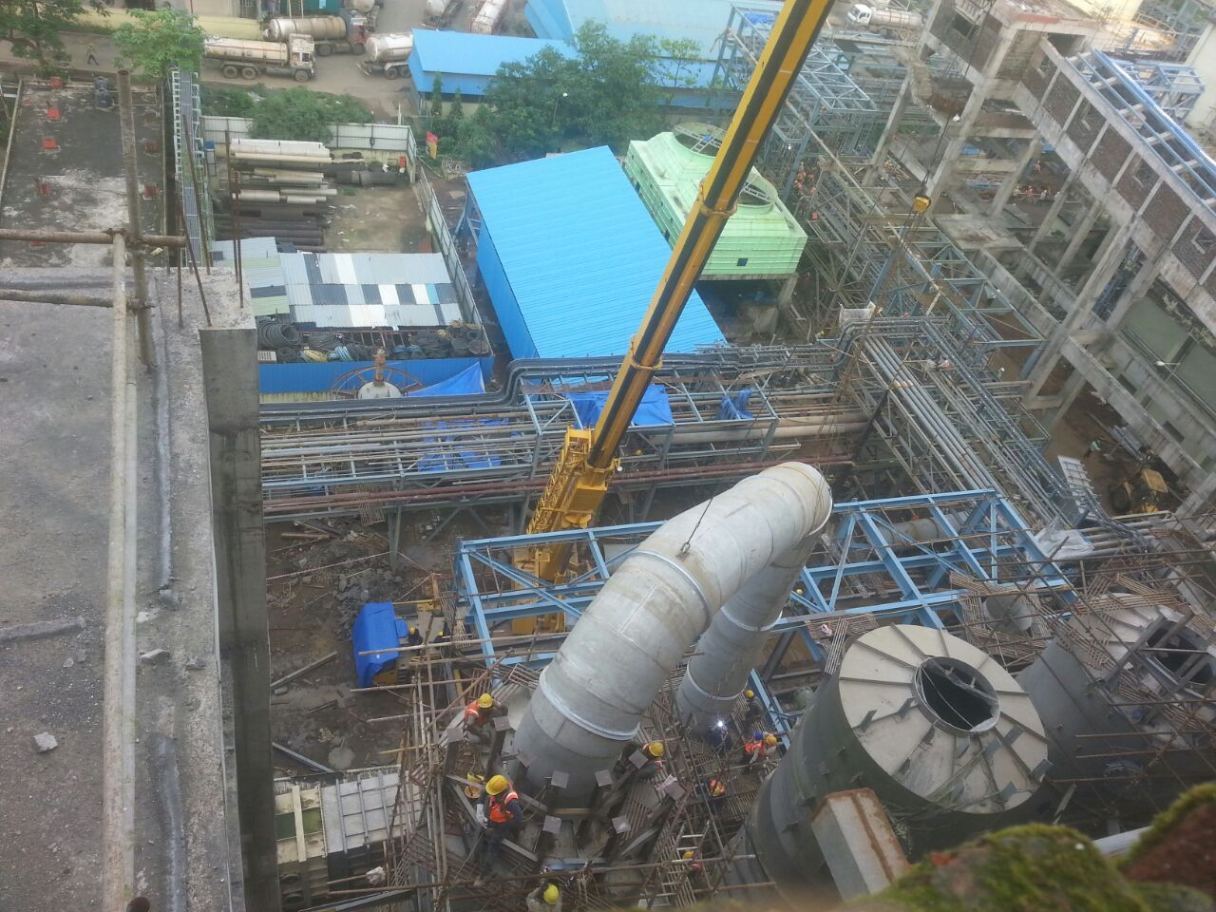
SUPPLY, FABRICATION & ERECTION OF PIPING WORK

Slide 10









SUPPLY, FABRICATION & ERECTION OF PIPING WORK

Slide 11












SUPPLY, FABRICATION & ERECTION OF PIPING WORK

Slide 12








CONSULTANTS WE HAVE WORKED WITH

Slide 13
Set Up & MANPOWER
MACHINERY AND SETUP
14 MT Hydra (2)
Welding Rectifiers
(163)
Grinding Machine (237)
Drilling Machines (69)
DG Set 63 KVA (8)
Workshop (1.25 Acre)
Chain Pulley Blocks (48)
Plate Rolling Machine (1)
MANPOWER STRENGTH
OFFICE STAFF : 20
QUALIFIED ENGINEERS/ SITE SUPERVISORS : 80
QUALIFIED WELDERS (6-G TESTED) : 36
SKILLED FABRICATORS : 52
HELPERS/ RIGGERS/ UNSKILLED : 554

Slide 14
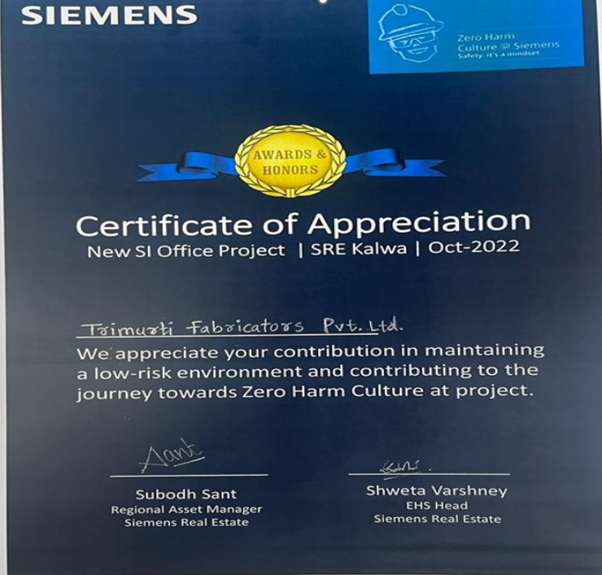
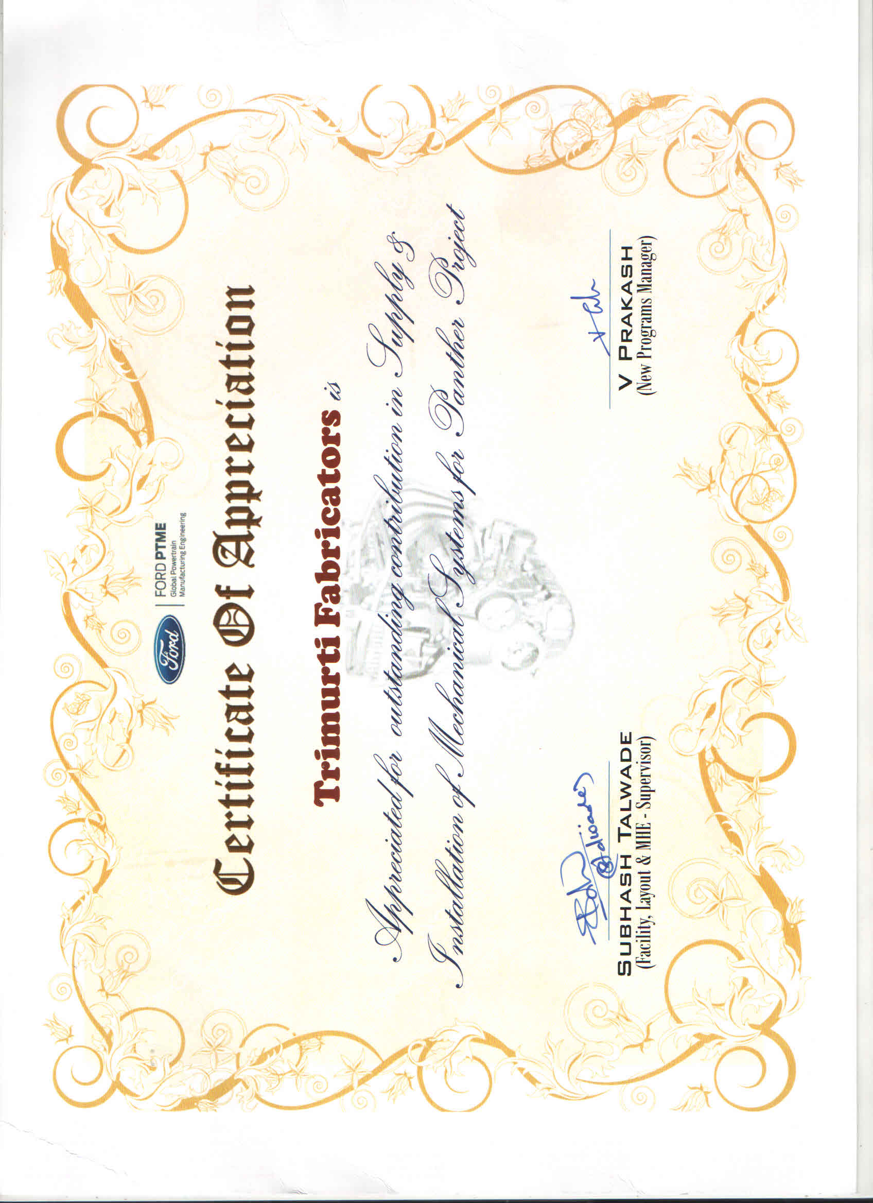
Certificates FROM OUR CLIENTS

Slide 15
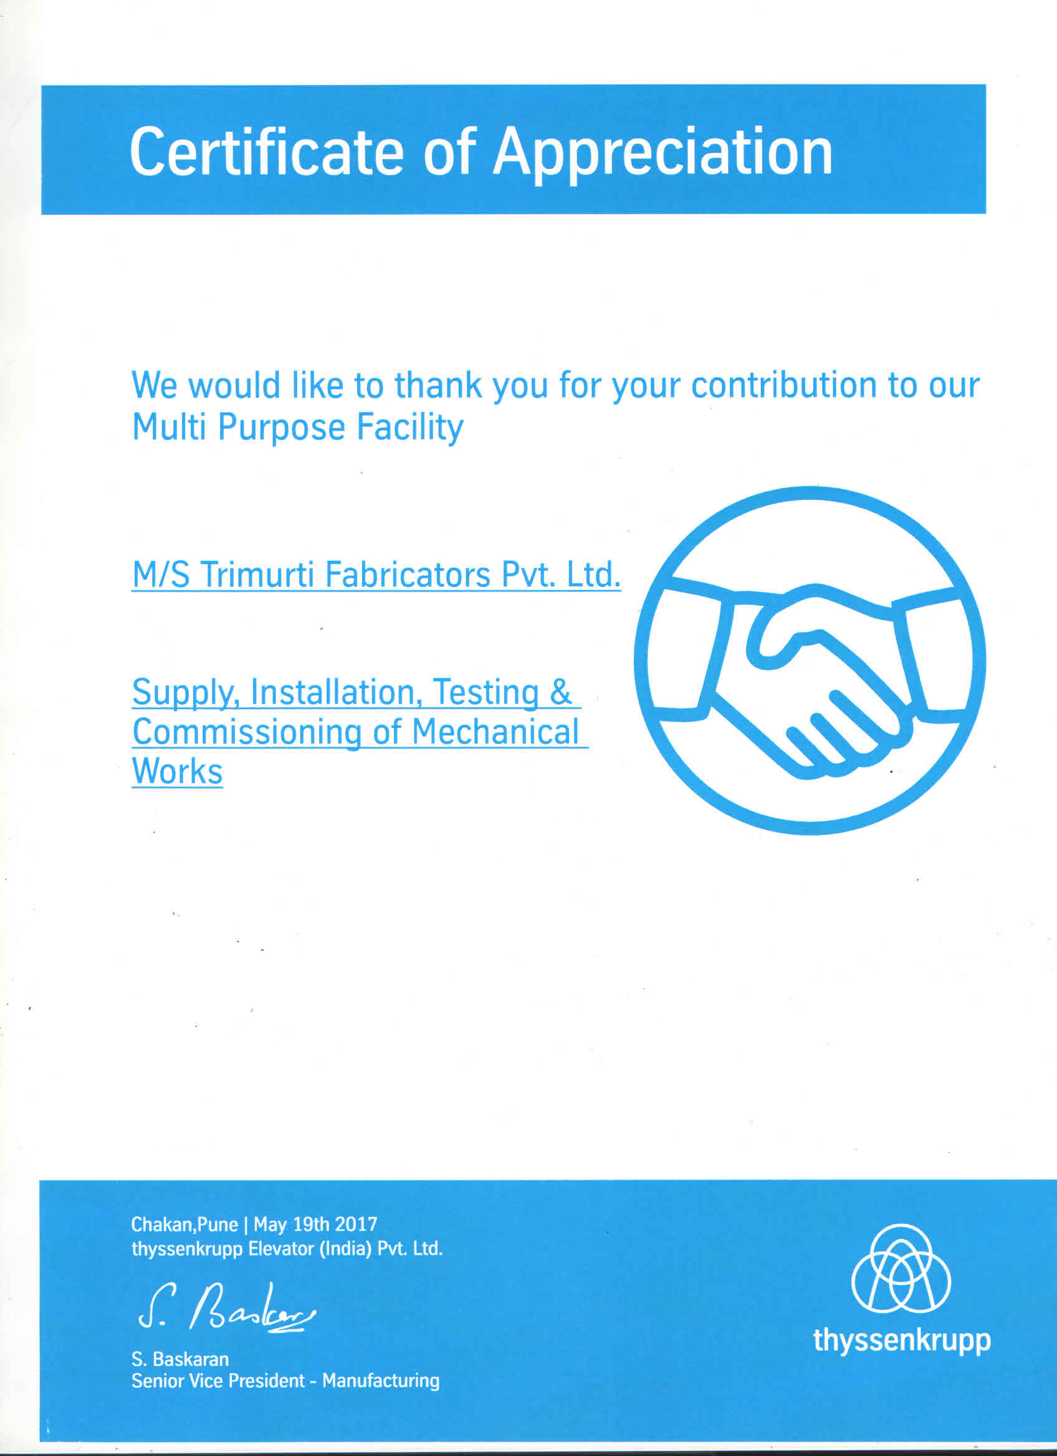
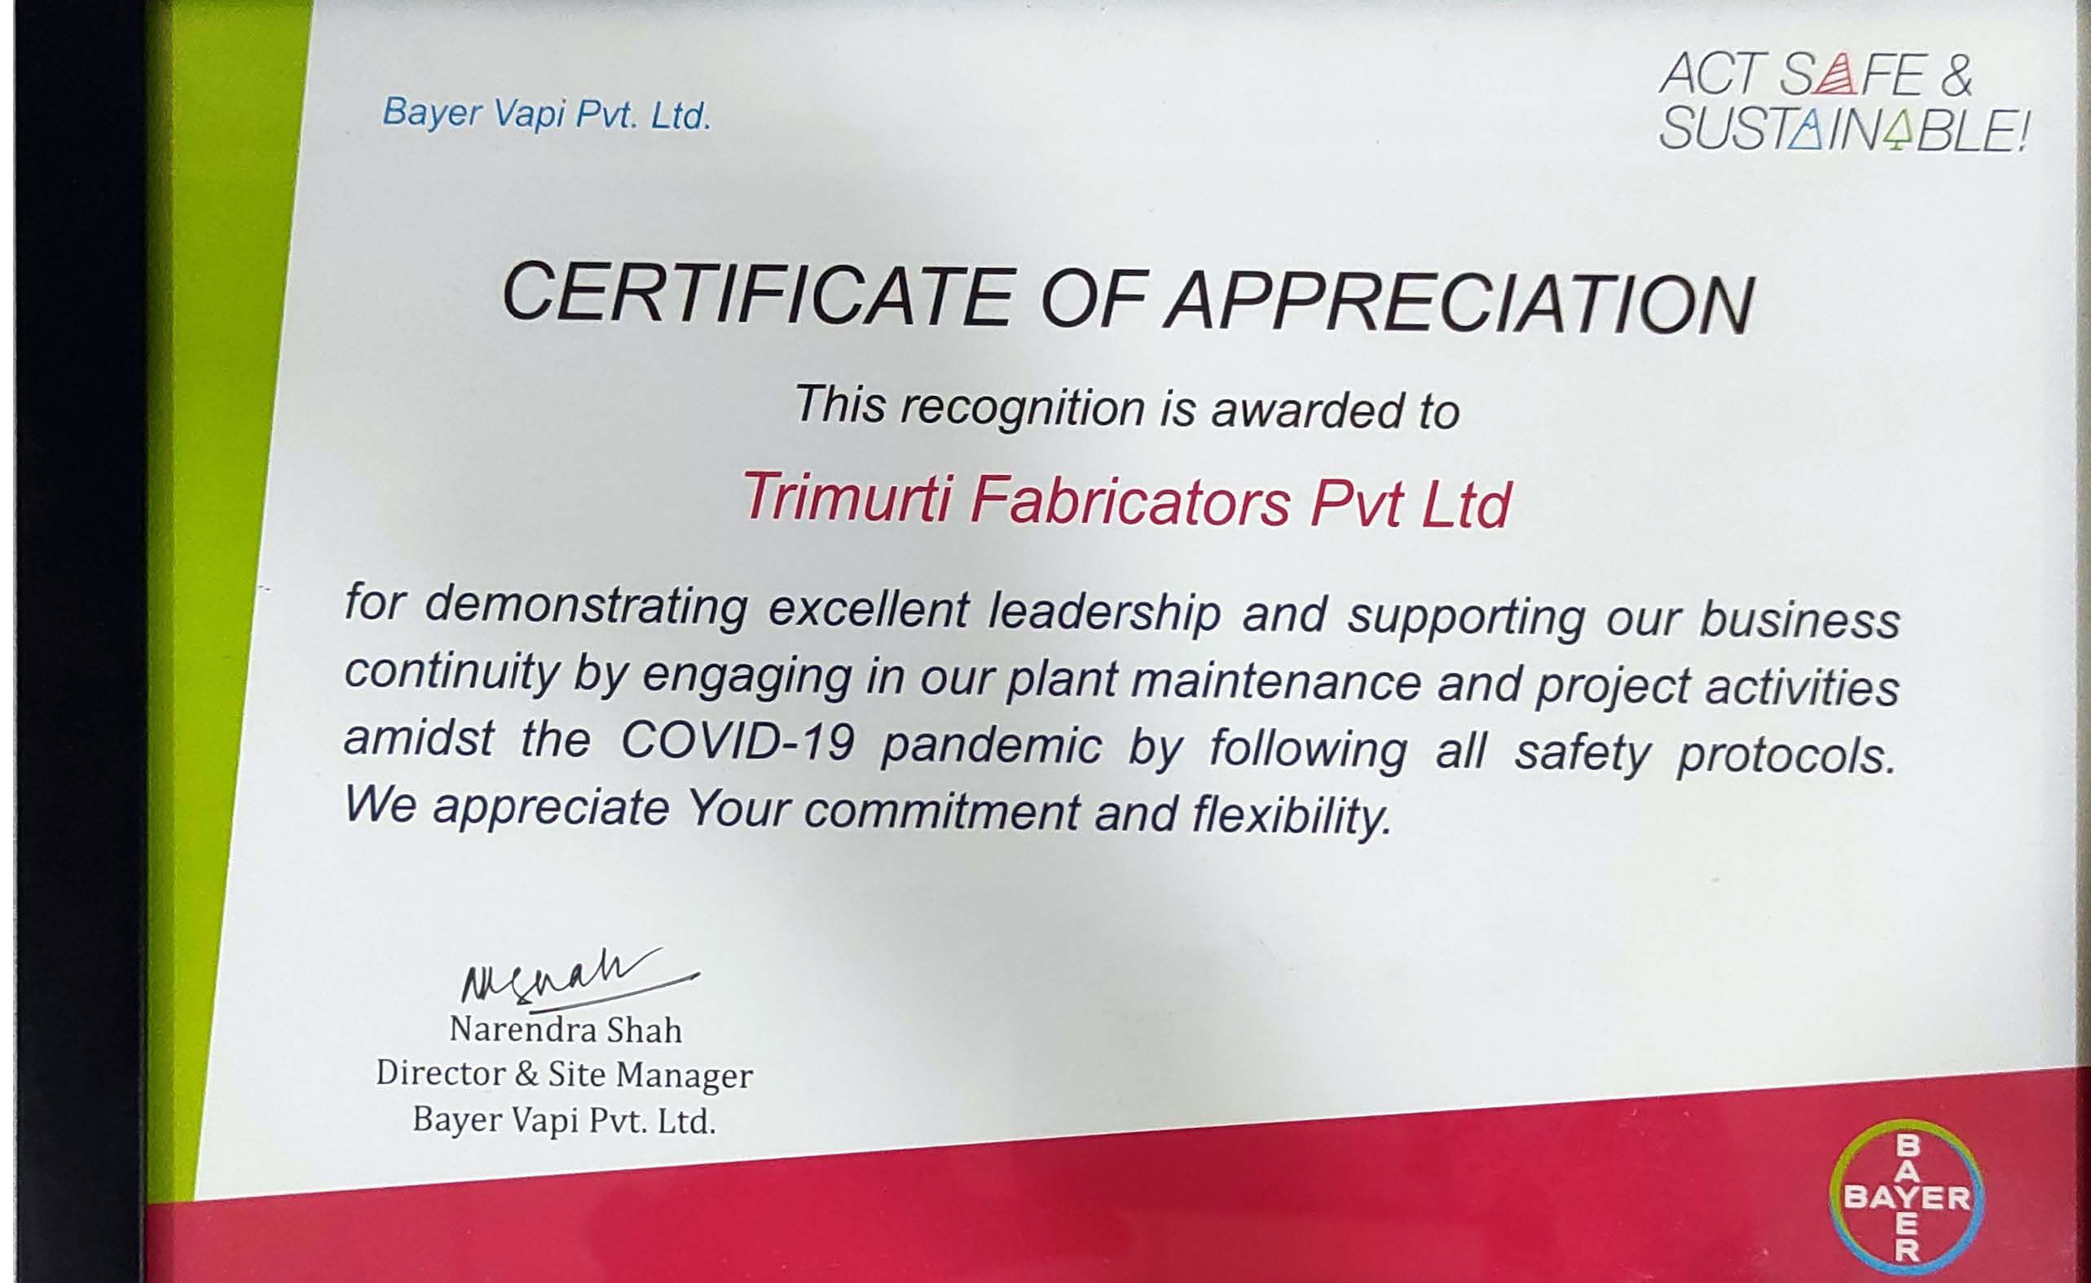
Certificates FROM OUR CLIENTS

Slide 16

THANK YOU
TRIMURTI FABRICATORS PVT LTD

